Slide 1
Manipulate data using PDO

Slide 2
Objectives
Selecting data using PDO
Transaction
Call StoredProcedure
Demo code using PDO

Slide 3


Selecting Data
Data is obtained via the ->fetch(), a method of your statement handle. Before calling fetch, it's best to tell PDO how you'd like the data to be fetched.
In reality, there are three which will cover most situations: FETCH_ASSOC, FETCH_CLASS, and FETCH_OBJ. In order to set the fetch method, the following syntax is used:

Slide 4
Selecting Data
You have the following options:
PDO::FETCH_ASSOC: returns an array indexed by column name
PDO::FETCH_BOTH (default): returns an array indexed by both column name and number
PDO::FETCH_BOUND: Assigns the values of your columns to the variables set with the ->bindColumn() method
PDO::FETCH_CLASS: Assigns the values of your columns to properties of the named class. It will create the properties if matching properties do not exist
PDO::FETCH_INTO: Updates an existing instance of the named class
PDO::FETCH_LAZY: Combines PDO::FETCH_BOTH/PDO::FETCH_OBJ, creating the object variable names as they are used
PDO::FETCH_NUM: returns an array indexed by column number
PDO::FETCH_OBJ: returns an anonymous object with property names that correspond to the column names

Slide 5
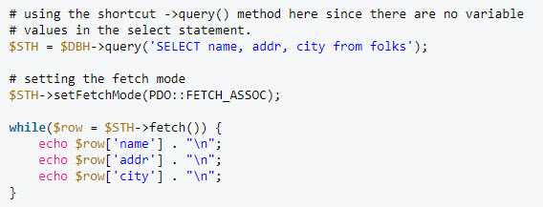
FETCH_ASSOC
This fetch type creates an associative array, indexed by column name. This should be quite familiar to anyone who has used the mysql/mysqli extensions.
The while loop will continue to go through the result set one row at a time until complete.

Slide 6
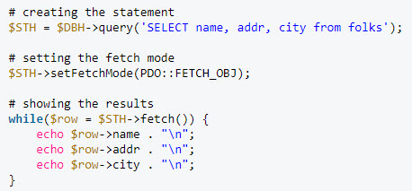
FETCH_OBJ
This fetch type creates an object of class for each row of fetched data.

Slide 7
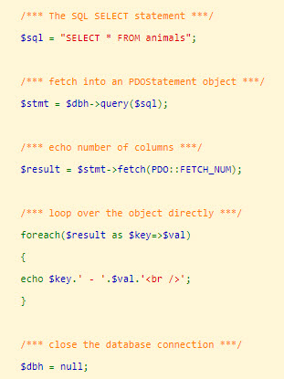

FETCH NUM
PDO::FETCH_NUM produces a numerical index of the result set rather than the field names.
Result

Slide 8
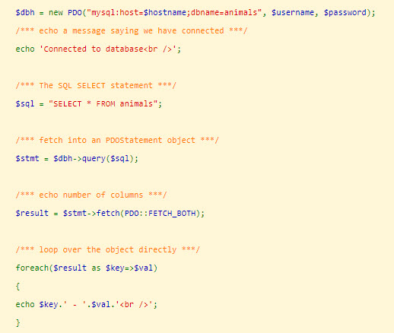
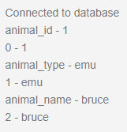
FETCH BOTH
There may be times you need to fetch both numerical and associative indexes. PDO::FETCH_BOTH produces a numerical and associative index of the result set so you can use either, or both.
Result

Slide 9
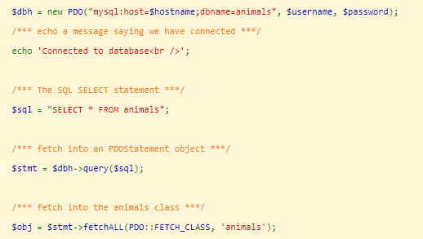
FETCH CLASS
PDO::FETCH_CLASS instantiates a new instance of the specified class. The field names are mapped to properties (variables) within the class called. This saves quite a bit of code and speed is enhanced as the mappings are dealt with internally.
Example

Slide 10

FETCH LAZY
PDO::FETCH_LAZY is odd as it combines PDO::FETCH_BOTH and PDO::FETCH_OBJ.
Example

Slide 11
Transactions
A PDO transaction begins with the with PDO::beginTransaction() method. This method turns off auto-commit and any database statements or queries are not committed to the database until the transaction is committed with PDO::commit.
When PDO::commit is called, all statements/queries are enacted and the database connection is returned to auto-commit mode.

Slide 12
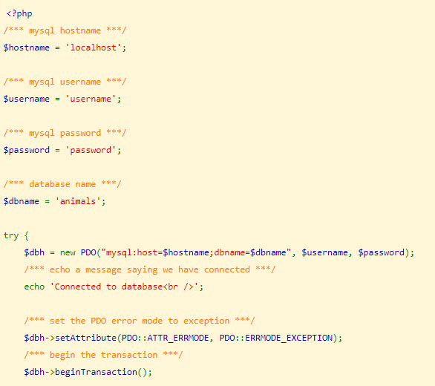
Transactions
Example

Slide 13
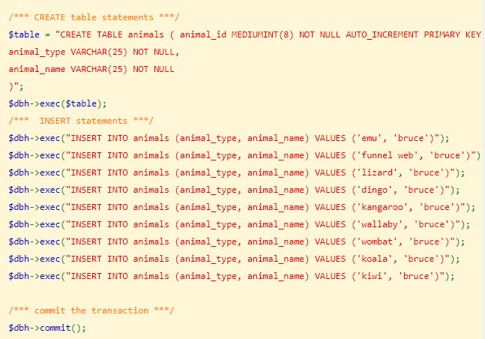
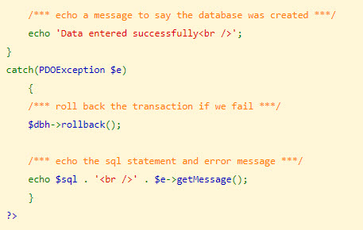
Transactions

Slide 14
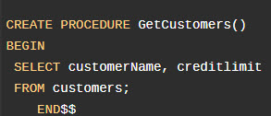
Call MySQL Stored Procedures
The steps of calling a stored procedure that returns a result set using PHP PDO are similar to querying data from MySQL database table using the SELECT statement.
Instead of sending a SELECTstatement to MySQL database, you send a stored procedure call statement.
Example

Slide 15
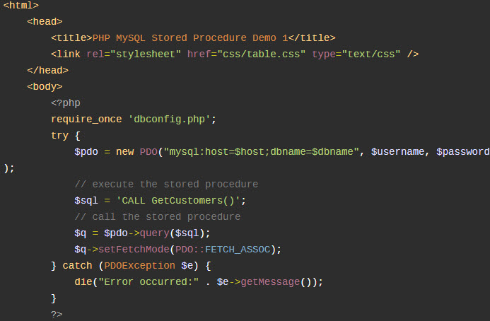
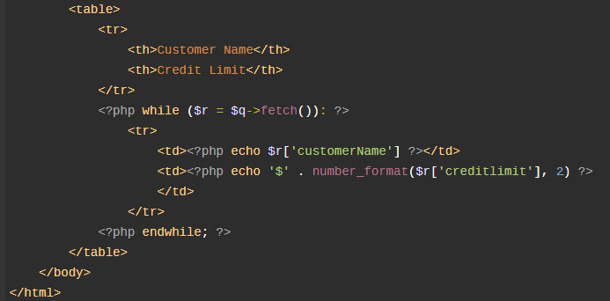
Call MySQL Stored Procedures

Slide 16
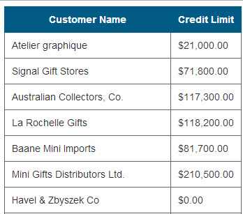
Call MySQL Stored Procedures
Output:

Slide 17
Demo
Teacher demo code about database CRUD operations using PDO

Slide 18
Summary
Selecting data using PDO
Transaction
Call StoredProcedure
Demo code using PDO

